Slide 1
Module name: ADAPTIVE SOCIAL PROTECTION
Session name: CASE STUDY
Analysis to Action:
An Executive Education Program on Disaster Risk Finance in Africa
2 – 6 September 2019
Stellenbosch University

Slide 2
Module: ADAPTIVE SOCIAL PROTECTION
CASE STUDY SESSION - OVERVIEW
15 MINS
READ THE CASE STUDY AND REFLECT ON THE WORKSHEET
30 MINS
GROUP DISCUSSSIONS ON PILOT PROGRAMME OUTLINE
30 MINS
GROUP FEEDBACK AND PRESENTATIONS ON PILOT PROGRAMME OUTLINE
15 MINS
WRAP-UP AND KEY LEARNINGS

Slide 3
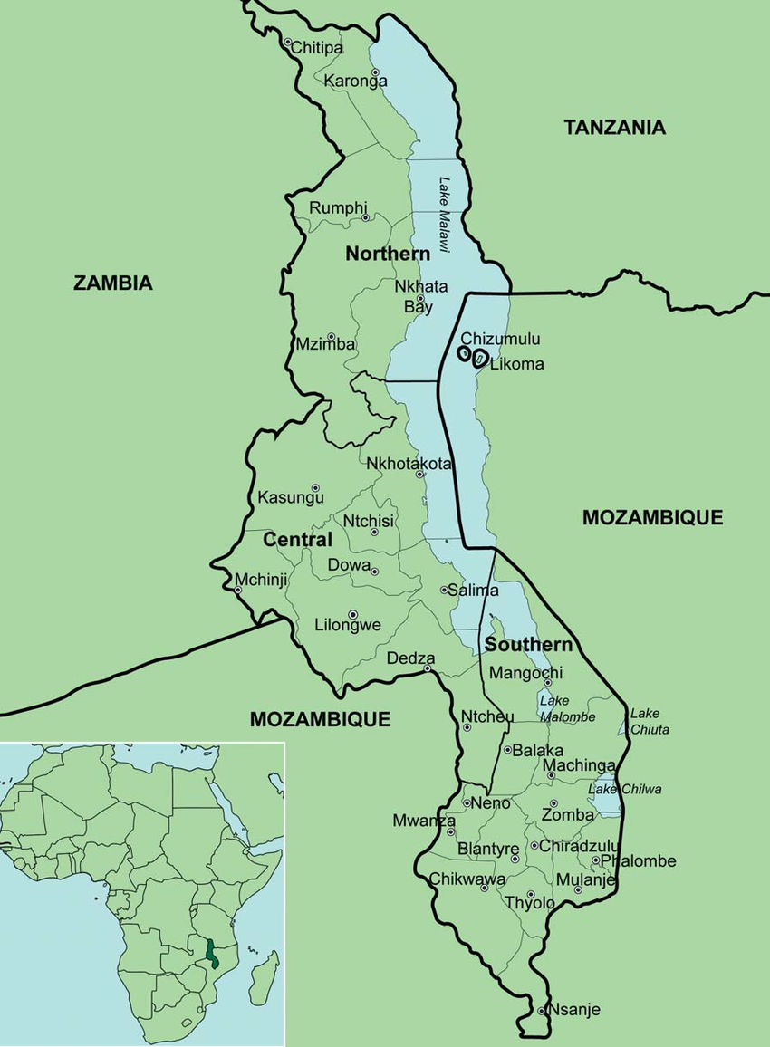
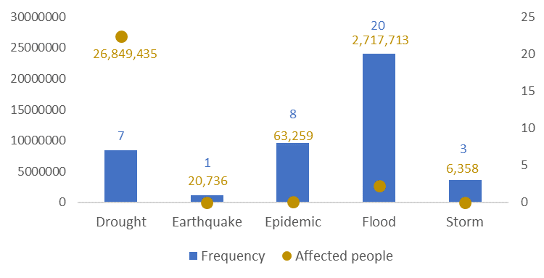
Module: ADAPTIVE SOCIAL PROTECTION
DESIGNING A SHOCK-RESPONSIVE SOCIAL PROTECTION PILOT PROGRAMME IN MALAWI:
TARGET AREAS
DATA AND DESIGN
ESTIMATED COSTS AND FINANCING INSTRUMENTS
KEY DISASTER RISKS

Slide 4
Module: ADAPTIVE SOCIAL PROTECTION
DESIGNING A SHOCK-RESPONSIVE SOCIAL PROTECTION PILOT PROGRAMME IN MALAWI:
CASE-STUDY CHALLENGE
Policy Priorities Define the Design of the Pilot Programme
DISCUSSION GROUPS:
MINISTRY OF FINANCE
SOCIAL PROTECTION MINISTRY
DEVELOPMENT BANK
KEY DISASTER RISKS
TARGET AREAS
DATA AND DESIGN
ESTIMATED COSTS AND FINANCING INSTRUMENTS
LIMITED FUNDING!!

Slide 5
Module: ADAPTIVE SOCIAL PROTECTION
DESIGNING A SHOCK-RESPONSIVE SOCIAL PROTECTION PILOT PROGRAMME IN MALAWI:
GROUP FEEDBACK:
KEY DISASTER RISKS
TARGET AREAS
DATA AND DESIGN
ESTIMATED COSTS AND FINANCING INSTRUMENTS

Slide 6
Module: ADAPTIVE SOCIAL PROTECTION
Six Steps Towards Strengthening Financial Resilience
Finalize the mechanism rules and devise a DRF strategy to support costs
Design the Scalability
Mechanism
Develop a risk profile
1
2
3
4
5
6
Decide on policy priorities
Estimate the cost of
Scalability mechanism
Monitoring and Evaluation

Slide 7
Module: ADAPTIVE SOCIAL PROTECTION
BUILDING BLOCKS
Information systems and targeting
Determine the amount of assistance needed
Identify affected populations to receive the assistance
Risk information and early warning system
Where vulnerable households are located
When and for how long the delivery mechanism will scale up
Delivery mechanism
How assistance will be channeled to affected population
Disaster
Risk Financing
How much the mechanism could cost, and develop appropriate strategies to finance response, with clarity on who pays.
Institutional coordination
How does the social protection scale ups complement disaster response and humanitarian assistance.

